Slide 1
CSE460: VLSI Design
Lecture 1

Slide 2
Very Large Scale Integration or VLSI

Slide 3
Contents
Topics of this course
History
Transistors
Moore’s law
Types of chips
Design abstraction
Design methodology

Slide 4
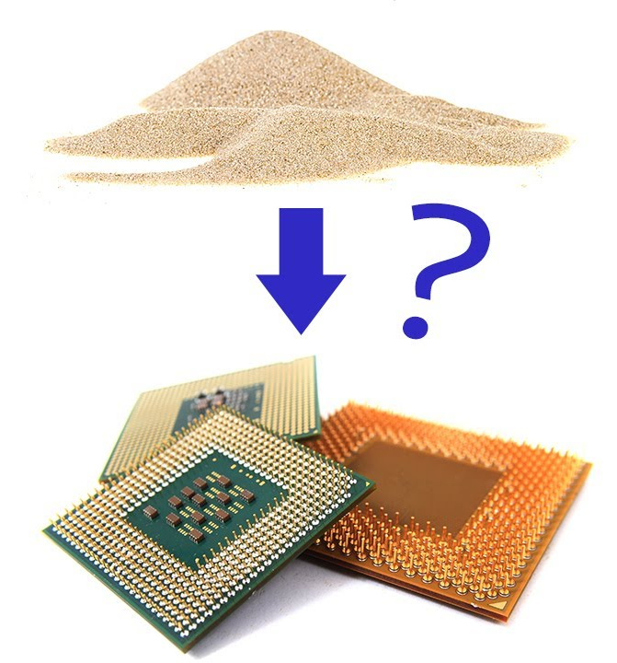
What will you learn in this course?
You may have heard people say that electronics are made from sand, but do you know how?

Slide 5
What will you learn in this course?
A solid introduction to VLSI
Different kinds of chips/ICs
How to build one
Theoretical background to making a good chip
Quality measures of a chip
The complete lifecycle of a chip

Slide 6
The Transistor
Transistor concept
Transistors can be viewed as electrically controlled switches with a control terminal and two other terminals that are connected or disconnected depending on the voltage or current applied to the control terminal

Slide 7
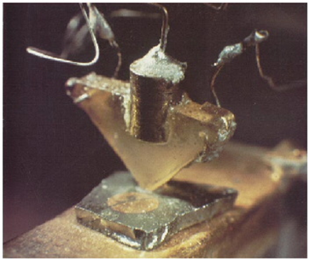
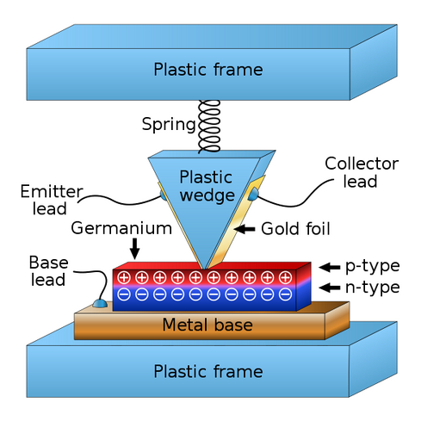
Transistor Invention
1947: First transistor was built
John Bardeen and Walter Brattain built the first functioning point contact transistor at Bell Labs
Nearly classified as military secret
Later publicly introduced by Bell Labs
Nobel Prize in Physics in 1956 for Bardeen, Brattain, and their supervisor William Shockley
We have called it the Transistor, T-R-A-N-S-I-S-T-O-R, because it is a resistor or semiconductor device which can amplify electrical signals as they are transferred through it from input to output terminals. It is, if you will, the electrical equivalent of a vacuum tube amplifier. But there the similarity ceases. It has no vacuum, no filament, no glass tube. It is composed entirely of cold, solid substances.

Slide 8
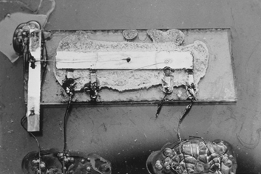
First IC
1959: U.S. Patent 3,138,743 for "Miniaturized Electronic Circuits"
Several years later after the invention of transistors, Jack Kilby at Texas Instruments realized the potential for miniaturization if multiple transistors could be built on one piece of silicon
Kilby received the Nobel Prize in Physics in 2000 for the invention of the integrated circuit

Slide 9
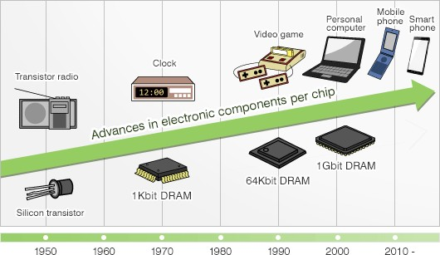
Evolution of Electronic Devices

Slide 10
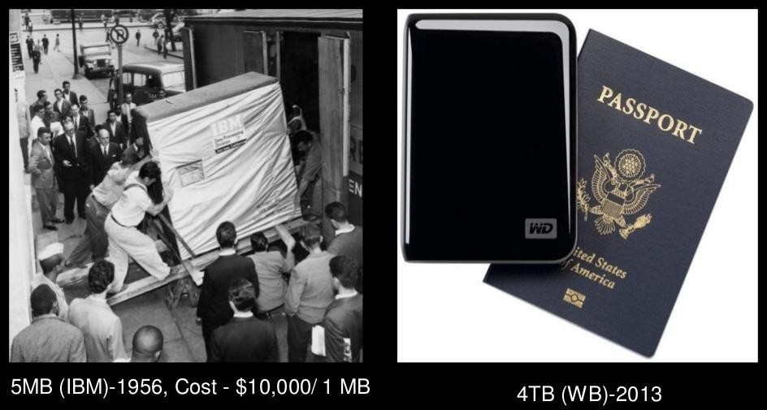
Evolution of Electronic Devices

Slide 11
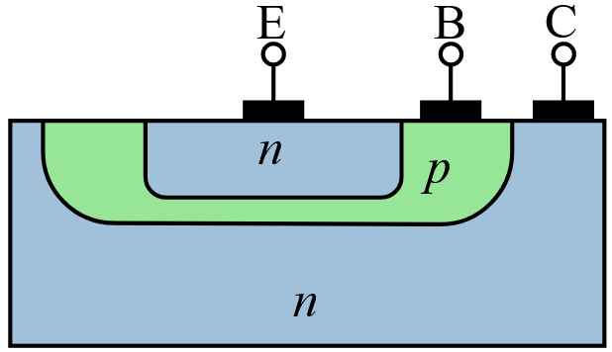
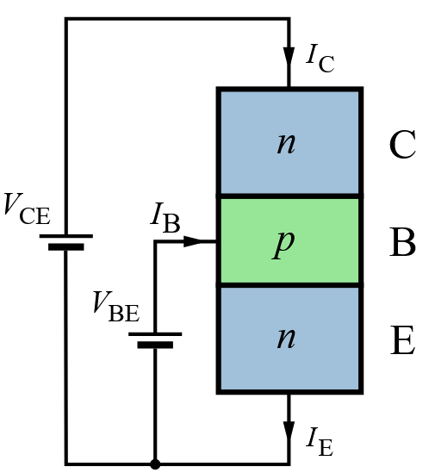
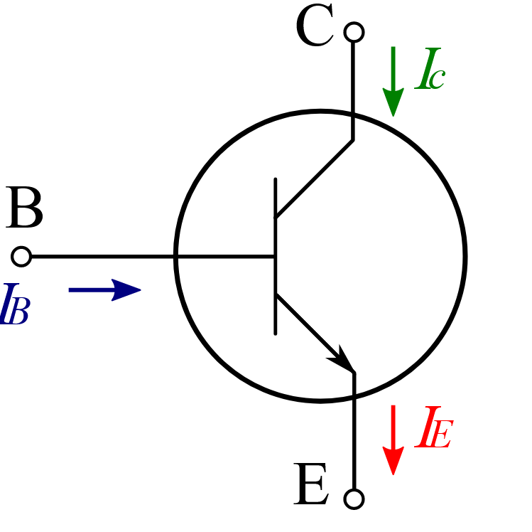
Bipolar Junction Transistor
Bipolar Junction Transistor (BJT)
Developed by Bell Labs
More reliable, less noisy, and more power-efficient than the point contact transistor
BJTs require a small current into the control (base) terminal to switch much larger currents between the other two (emitter and collector) terminals
Power being dissipated by these base currents even when idle

Slide 12
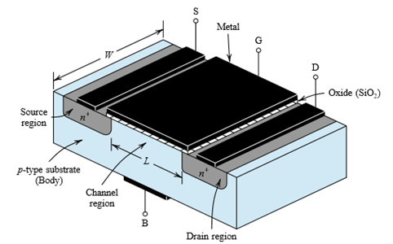
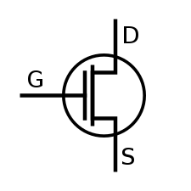
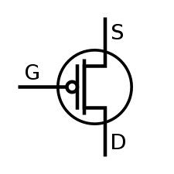
Metal Oxide Semiconductor Field Effect Transistor
1960s: (MOSFETs) began to enter production
Metal Oxide Semiconductor Field Effect Transistors or MOSFETs offer the compelling advantage that they draw almost zero control current while idle.
Two flavors: nMOS and pMOS
Three terminals: Gate (control), Drain and Source

Slide 13
First MOSFET Gates
1963: First logic gate using MOSFETs
Frank Wanlass at Fairchild described the first logic gates using MOSFETs
Fairchild’s gates used both nMOS and pMOS transistors, earning the name Complementary Metal Oxide Semiconductor, or CMOS
The circuits used discrete transistors but consumed six orders of magnitude less power than their bipolar counterparts
With the development of the silicon planar process, MOS integrated circuits became attractive for their low cost because each transistor occupied less area and the fabrication process was simpler
Integration Levels
SSI: 1-12 gates
MSI: 13-99 gates
LSI: 100-9999 gates
VLSI: 10-99.9 k gates
ULSI: >100k gates

Slide 14
Integration Levels
Name |  | No of Transistors | No of Logic Gates
Small-Scale Integration (SSI) |  | 1 to 10 | 1 to 12
Medium-Scale Integration (MSI) |  | 10 to 500 | 13 to 99
Large-Scale Integration (LSI) |  | 500 to 20,000 | 100 to 9,999
Very Large Scale Integration (VLSI) |  | 20,000 to 1,000,000 | 10,000 to 99,999
Ultra Large Scale Integration (ULSI) |  | 1,000,000 and more | 100,000 and more

Slide 15
Trend in MOSFET IC Design
Early commercial processes used only pMOS transistors and suffered from poor performance, yield, and reliability
Processes using nMOS transistors became common in the 1970s
While nMOS process was less expensive than CMOS, nMOS logic gates still consumed power while idle
Power consumption became a major issue in the 1980s as hundreds of thousands of transistors were integrated onto a single die
CMOS processes were widely adopted and replaced all the other technologies (pMOS, nMOS)

Slide 16
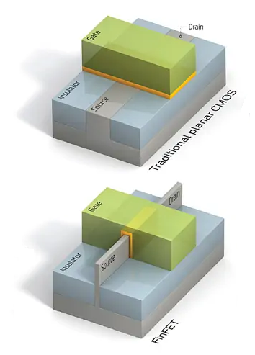
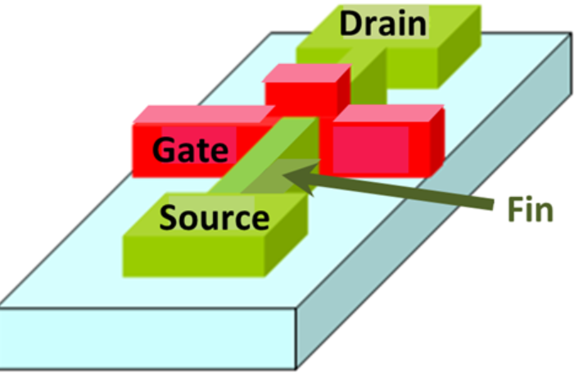
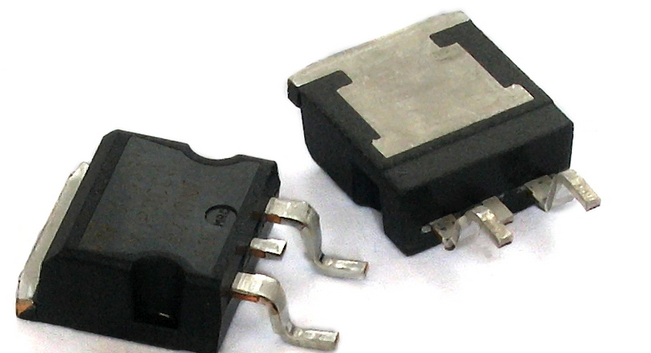
Types of MOSFET
pMOS, nMOS, CMOS
Metal–insulator–semiconductor field-effect transistor (MISFET)
Floating-gate MOSFET (FGMOS)
Power MOSFET
Multi-gate field-effect transistor (MuGFET)
Quantum field-effect transistor (QFET)

Slide 17
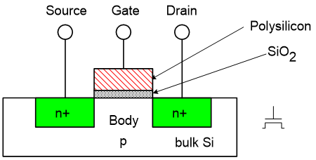
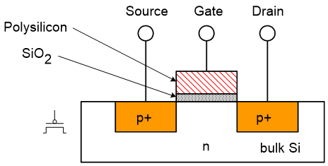
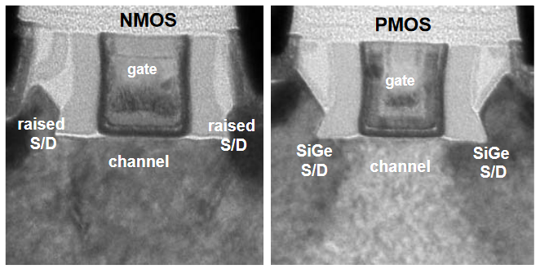
A Closer Look
Packan P, Akbar S, Armstrong M, et al. High performance 32nm logic technology featuring 2nd generation High-k + metal gate transistors. In: International Electron Devices Meeting, IEEE, 2009. 659–662
Cross sectional view of intel’s 32nm CMOS devices

Slide 18
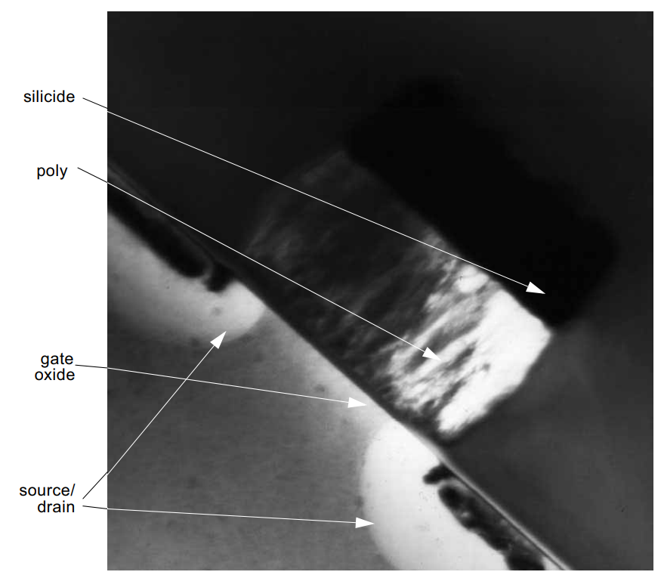
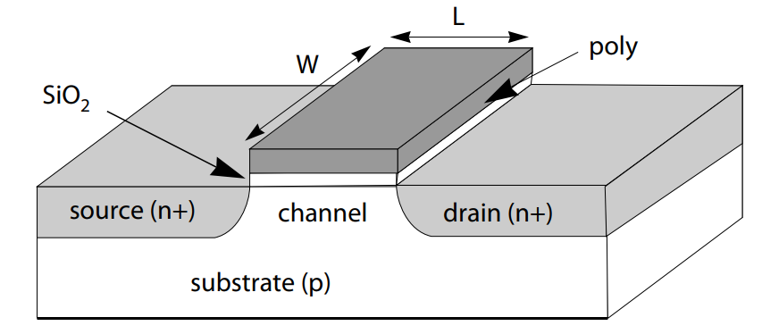
A Closer Look
Photomicrograph of a submicron MOS transistor (courtesy Agere)

Slide 19
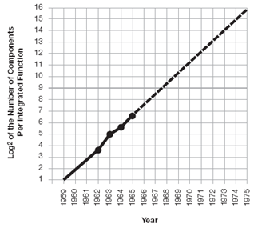
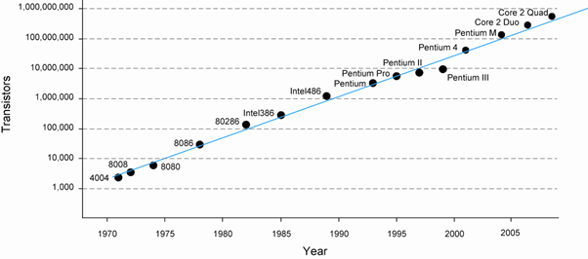
Moore’s Law
1965:Gordon Moore plotted # transistors on each chip vs year
Fit straight line on semi-log scale
Transistor counts have doubled about every 2 years

Slide 20
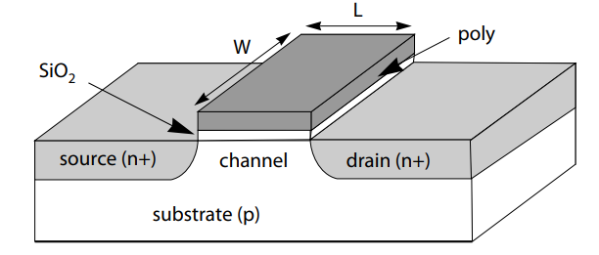
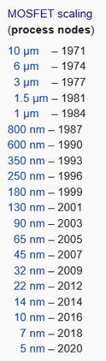
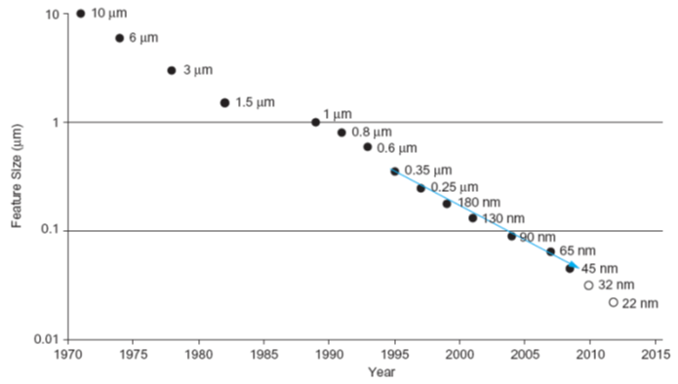
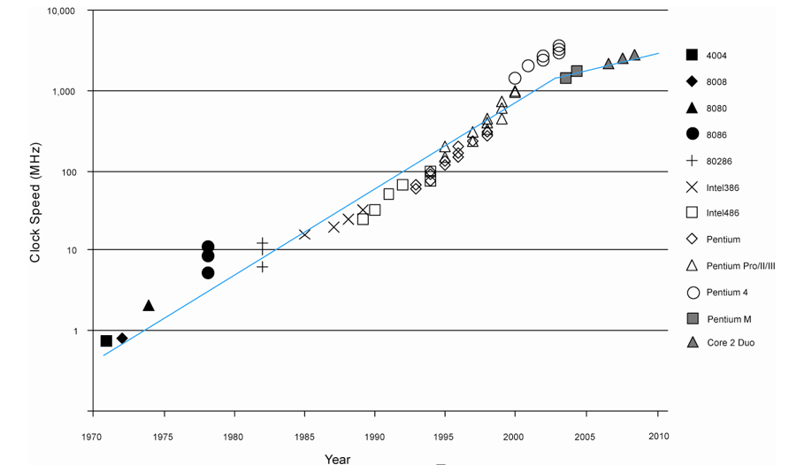
Moore’s Law
Process generations
A manufacturing technology at a particular channel length (feature size) is called a technology node/process node (micron, submicron, nanometer technologies)

Slide 21
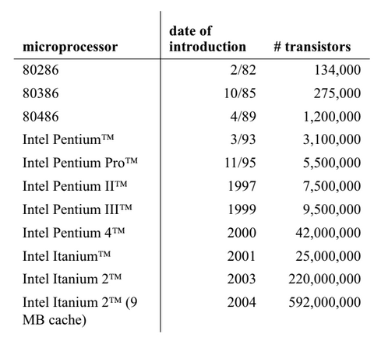
Moore’s Law
Moore’s law and intel microprocessors

Slide 22
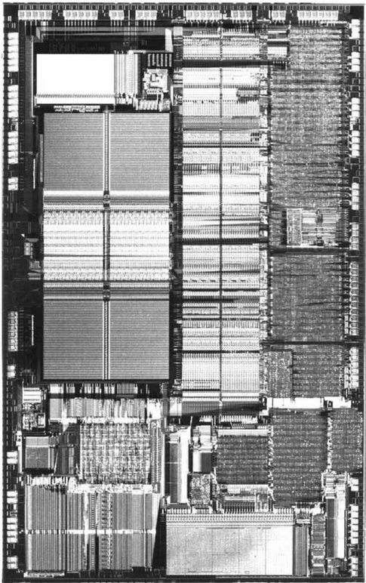
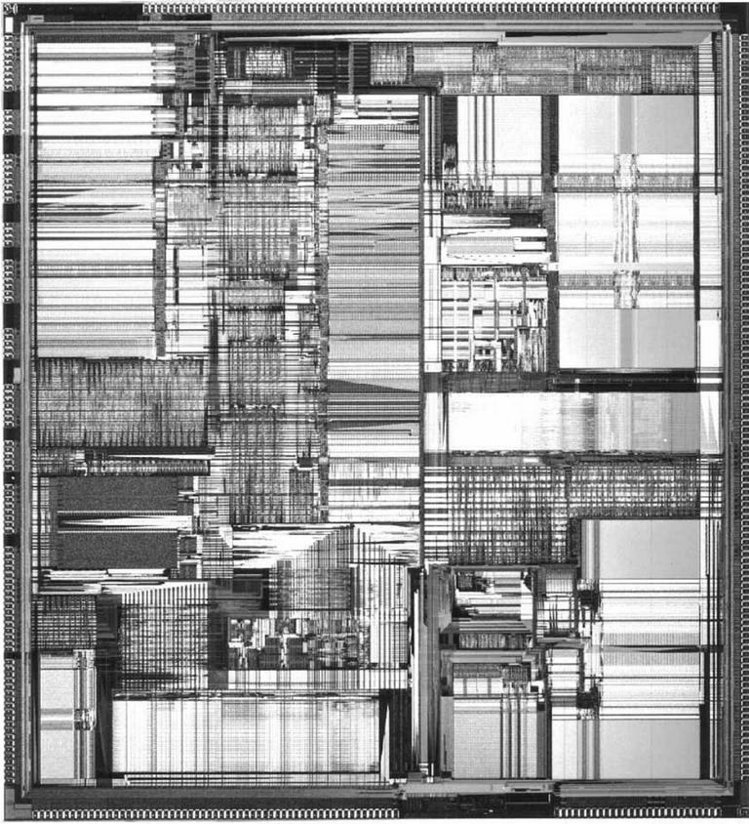
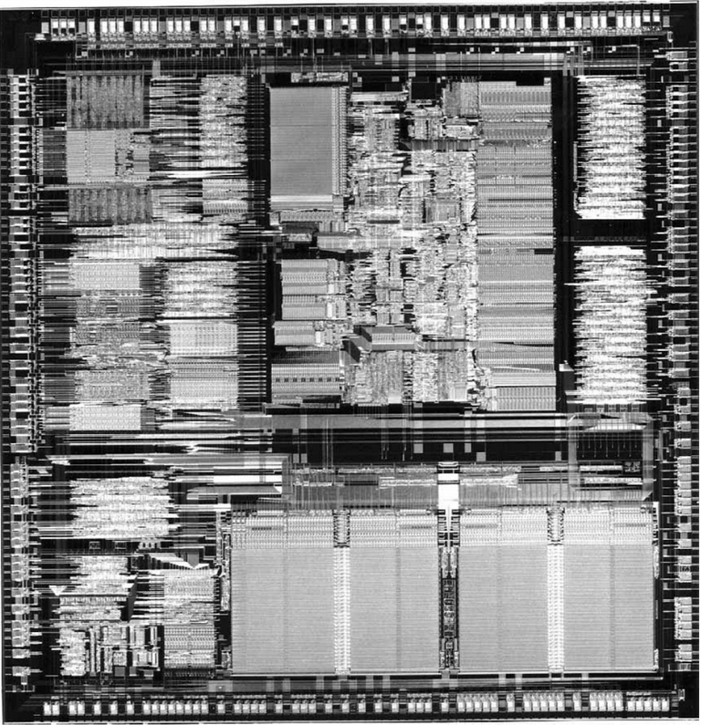
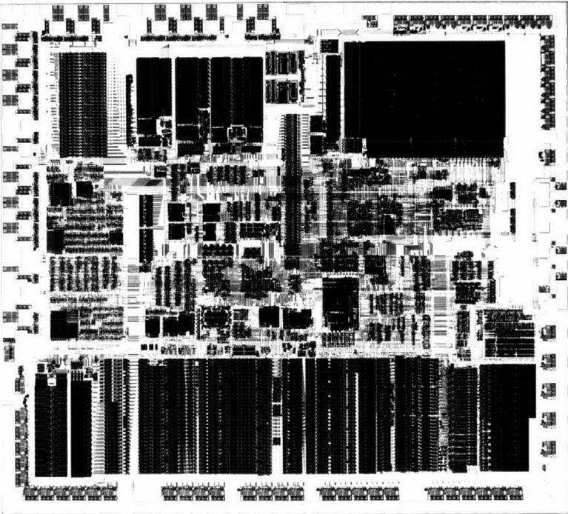
Intel Processors over the years
80286, 80386, 80486, Pentium

Slide 23
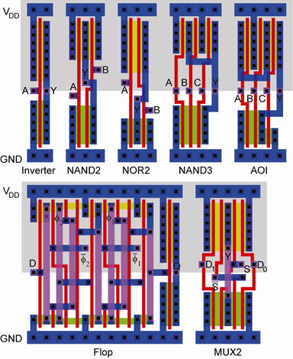
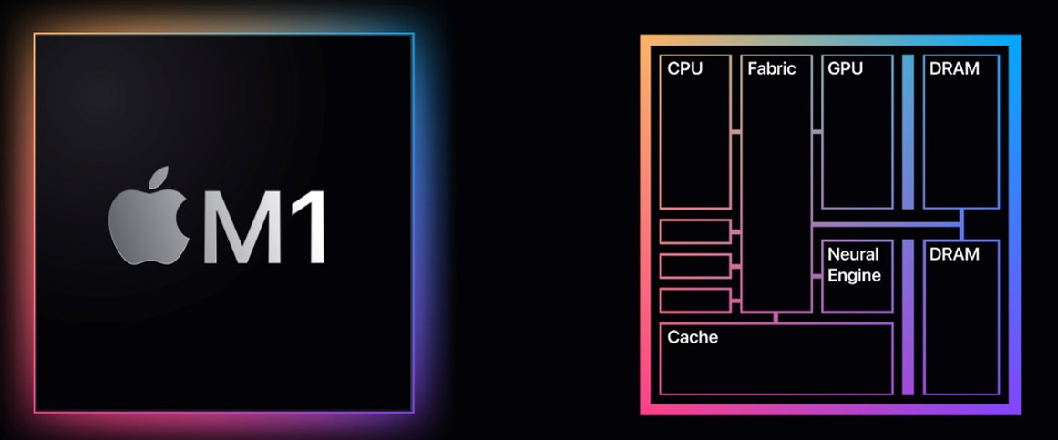
Types of chips
Cell-based design
In the 1960s, standard parts were logic gates; in the 1970s they were LSI components. Today, standard parts include fairly specialized components: communication network interfaces, graphics accelerators
Full custom
Designed manually piece by piece, fully custom layouts
Application-specific integrated circuits (ASICs)
Rather than build a system out of standard parts, designers can now create a single chip for their particular application
Systems-on-chips (SoCs)
a single-chip computer can include a CPU, bus, I/O devices, and memory

Slide 24
VLSI Chip Types
VLSI chips are classified by the approach used to implement and build the circuit
» Full-custom Design: where every circuit is custom designed for the project
Extremely tedious
Time-consuming process
» Application-Specific Integrated Circuits (ASICs): using an extensive suite of CAD
tools that portray the system design in terms of standard digital logic constructs
Including state diagrams, functions tables, and logic diagram
Designer does not need any knowledge of the underlying electronics or the physic of the silicon chip
Major drawback is that all characteristics are set by the architectural design
» Semi-custom Design: between that of a full-custom and ASICs
Using a group of primitive predefined cells as building blocks, called cell library

Slide 25
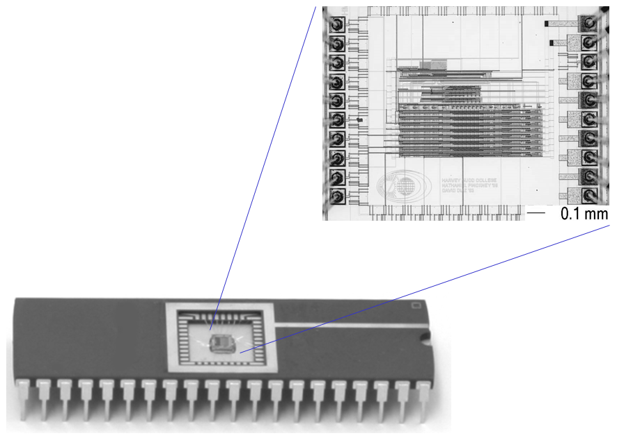
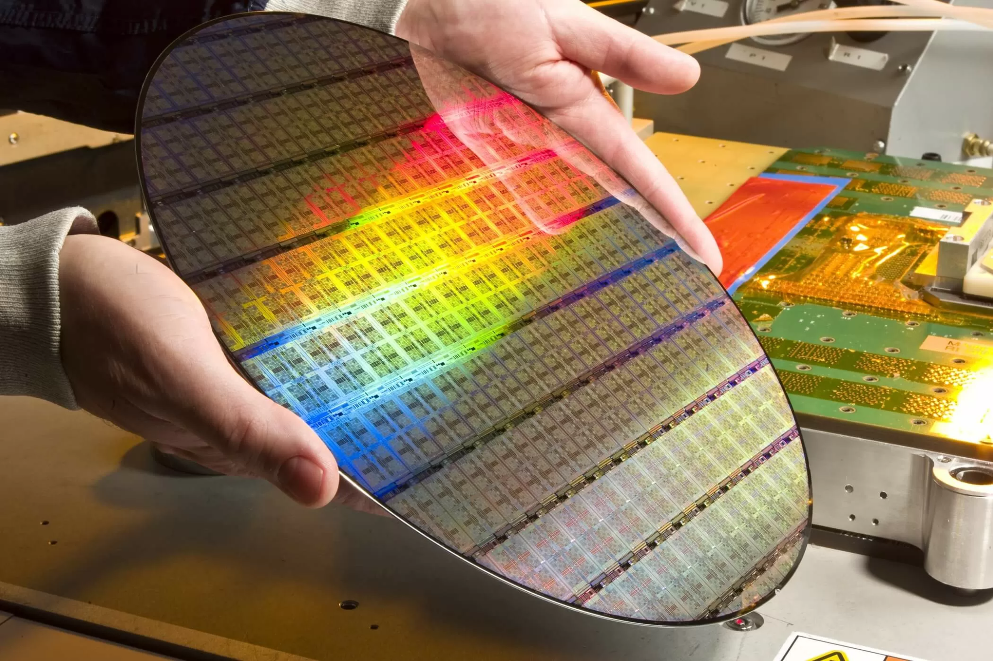
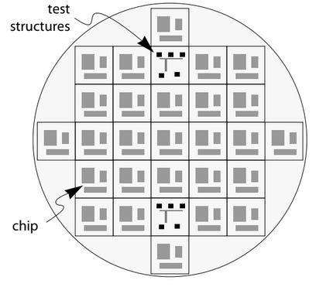
Chip Lifecycle
A wafer > fabrication > chips > packaging

Slide 26
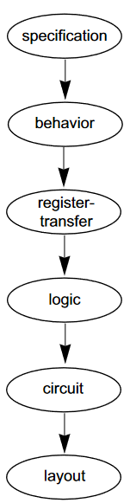
Abstraction levels
Specification
A set of requirements, not a design
Behavior
generally modeled as some sort of executable program
Register-transfer
The system is specified as Boolean functions stored in abstract memory elements
Logic
The system is designed in terms of Boolean logic gates,latches, and flip-flops
Circuit
The system is implemented as transistors
Layout
The final design for fabrication

Slide 27
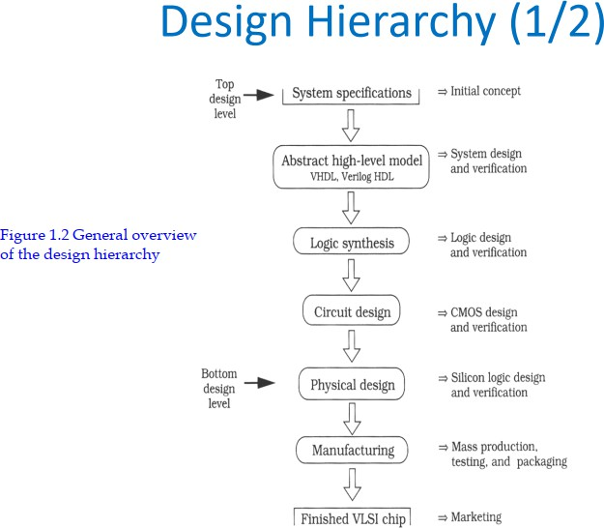

Slide 28
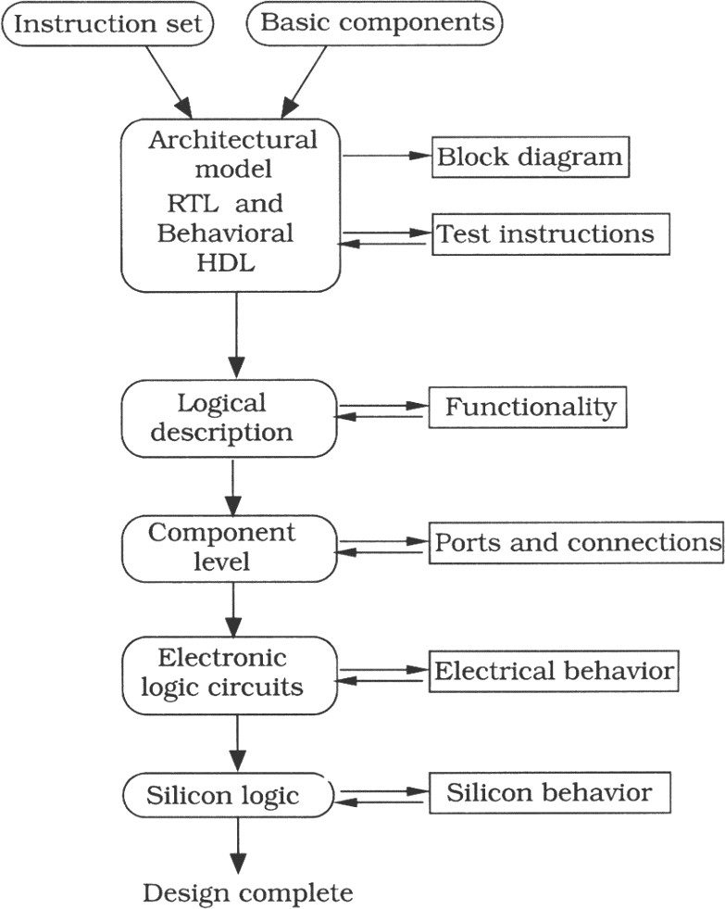
A Simple Design Flow
An example of a design hierarchy in Figure 1.3
– an instruction design of a microprocessor
Register_X ← A + B
Figure 1.3 A simple design flow for a microprocessor
Reading from the text book…..

Slide 29
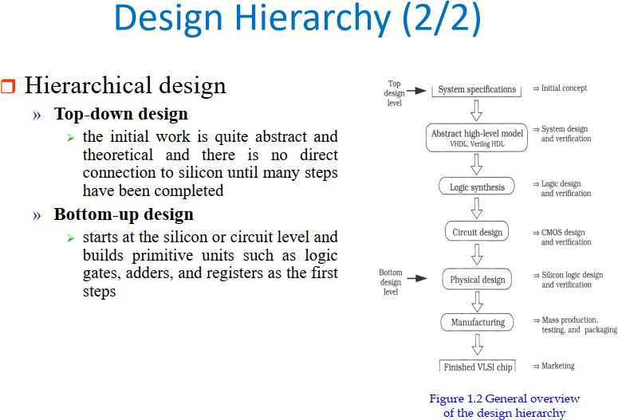

Slide 30
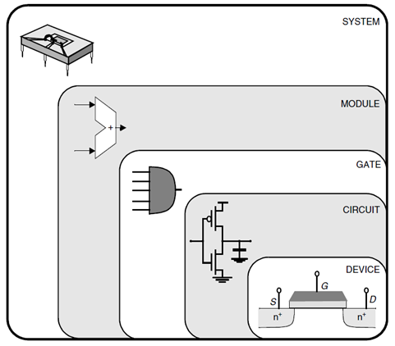
Design methodologies
Top-down approach
Start from the specification and reach device specification
Bottom-up approach
Start from the device optimization and go up to meet specification

Slide 31
Text
# | Title | Author(s) | Edition
1 | CMOS VLSI Design | N.H.E. Weste, D. Harris & A. Banerjee | 4th ed.
2 | Fundamentals of Digital Logic with Verilog Design | Stephen Brown & Zvonko Vranesic | 2nd/3rd ed.

Slide 32
Transistors = Switches

Slide 33
Slide References
https://en.wikipedia.org/wiki/MOSFET
https://www.techspot.com/article/1840-how-cpus-are-designed-and-built-part-3/
https://ieeexplore.ieee.org/document/5424253
Wayne Wolf - Modern VLSI Design IP based design
Jan M. Rabaey - Digital Integrated Circuits
Weste and Harris - CMOS VLSI Design

Slide 34
Thank you!

